Slide 1
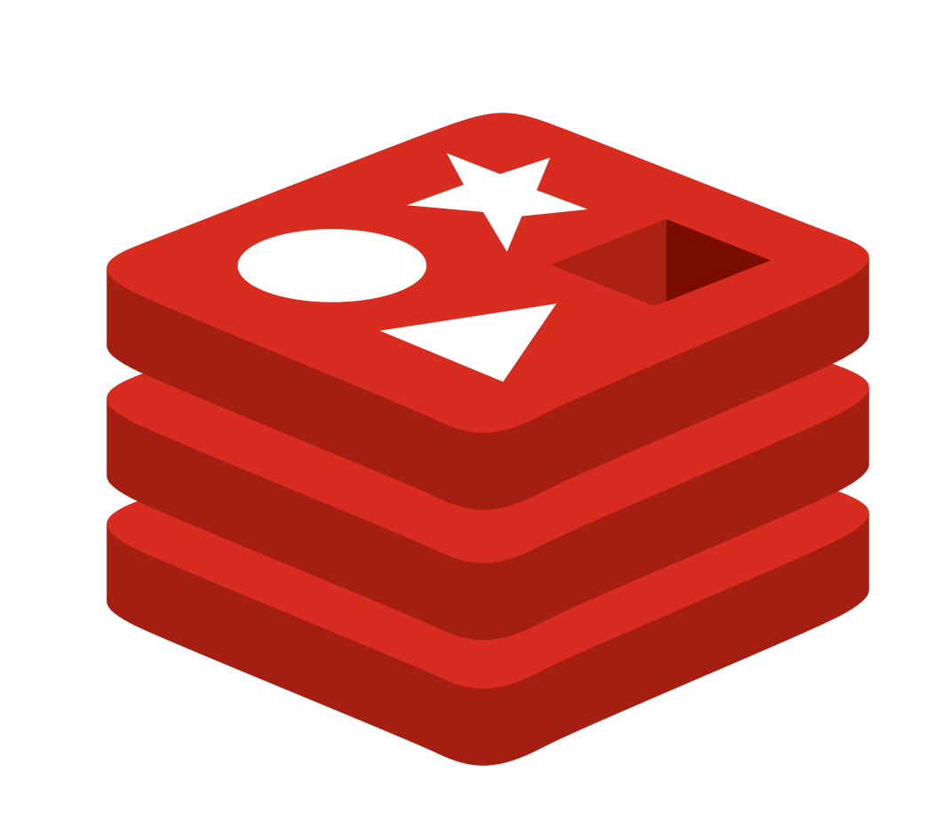
Logical
Presentation Layer
Application Layer
DB Layer
Client Browser
Redis
.NET Core API
MS SQL DB
React JS

Slide 2
Logical
UI
API
Cache
Repository
DB
Redis
UI (React JS)
.NET Core API
Repository
MS SQL DB

Slide 3
Components
UI
API
Cache
Repository
DB
Products Service
Redis
Categories Service
Repository with Dapper ORM
React JS with
Redux toolkit
Product Service
User Service
MS SQL DB

Slide 4
Components
Frontend- ReactJS
Frontend- ReactJS
DB Layer
Categories Service
Products Service
Redis
Cart UI
Popular Products
Search Product
MS SQL DB
Products by Category
Redux Toolkit
Auto suggest Product
Related Products
Add Product
Update Product
Delete Product
Auth. Service

Slide 5
User
UI
UI - State
UI Local Store
API
Redis
DB
Latest - 1
Visit Home Page
Request products
Fetch products
Get cached products
Return products
Query DB if cache miss
Return products
Search products
Request Search
Query search
Get cached results
Return products
Query DB if cache miss
Return search results
Search box
Request auto suggest
Fetch auto search
Get cached suggestions
Return results
Return auto suggestions
Query DB if cache miss
Add to Cart
Request add to cart
Store item to local
Result to UI
Remove from Cart
Delete from cart
Remove from Store
Result to UI
View Cart
Request cart items
Get items from Store
Return cart items
Login
Request Login
Get if logged
Get if not already logged in
Validated log in
Return result
Return validation result

Slide 6
User
UI
UI - State
UI Local Store
API
Redis
DB
Latest - 2
Related products
Req. rel. products
Fetch related products
Get cached related products
Return related products results
Query DB if cache miss
Return results
Add product request
Add product request
Insert product record
Return status for adding product
Update product request
Update product
Update request
Query DB if cache miss
Return status
Return status
Delete product request
Delete Product
Delete request
Return status
Remove product record
Return status

